Slide 1
Welcome to English 4 –
Shakespeare
Mrs. Buchholz

Slide 2
Why me?
I have my Bachelor’s degree in Literature with a minor in writing
I have my Master’s Degree in English/Emphasis on British Literature
I have my Secondary Teaching Credential
I have taught Brit Lit for the last 13 years!
This is my 15th year at Pondo! Go Bruins!

Slide 3
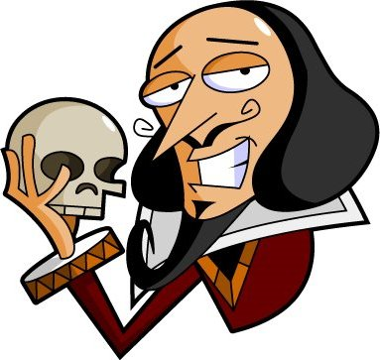
Why Shakespeare?
Shakespeare is often consider the greatest writer of the English Language
His stories are timeless
His writing is clever and he made up many words
We will probably laugh a lot in class!

Slide 4
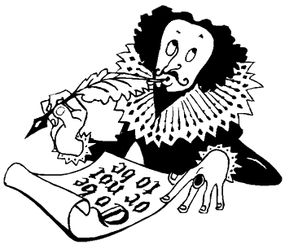
The man, the works, the legends, the myths
We will study the writer himself
We will study some of his works
We will study some of the controversy surrounding him
The class is called, “Shakespeare,” after all….

Slide 5
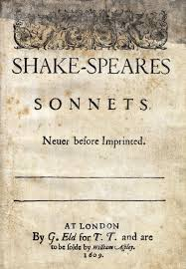

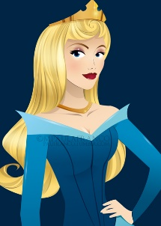


Sonnets!
He wrote 154 of them!
They are all in iambic pentameter – pretty cool!
They are a little controversial…
Although some are about love, many are about time, beauty and mortality.

Slide 6

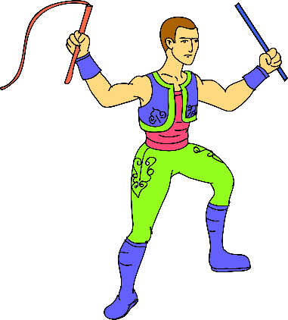
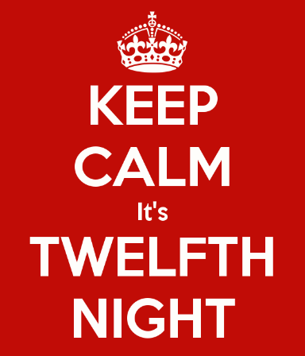

Comedies
Taming of the Shrew
Twelfth Night
The Tempest

Slide 7



Tragedies
Othello
Macbeth
Hamlet
And maybe a history or two…

Slide 8
Essays
College essay
Hamlet versus Macbeth
A personal reflection essay
And a few minor ones here and there!
Play versus movie analysis

Slide 9

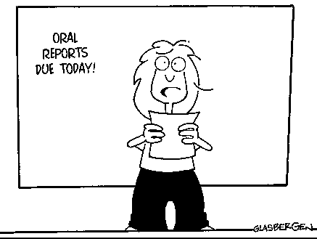
Unit projects/assessments
Keep notes! You will need them!
Assessments will vary by unit in the form of:
  Essays
  Exams
  Quizzes
  Projects
  Presentations

Slide 10
College?
Whether you are going to college or not, this is a college prep class
When you are done here, you will be ready!
Also, keep close attention to your grades!
You have to pass to Graduate!
Contact me by phone or email for any problems or concerns!

Slide 11
No excuses!!
http://bruin.eduhsd.k12.ca.us/

Slide 12
The End

