Slide 1
Welcome to British Literature
Mrs. Buchholz

Slide 2
Who Am I?
I have a Major in Literature and a Minor in Writing
Graduated 2000
I have my Secondary Teaching Credential
I have my Master’s degree in English!
Woohoo!!
It was a lot of work but worth it!
This is my 11th year at Ponderosa
Go Bruins!

Slide 3

Why Brit Lit?
Brit Lit is the original Senior English
Earliest recorded Literature
Printing started in Europe
Cause it’s cool and people die!!

Slide 4
Anglo-Saxons
First we begin with the Anglo-Saxon warriors and Kings
Then to “Beowulf” - the hero.

Slide 5
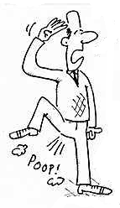
A Tale of Tales
Then on to “Canterbury Tales” by Chaucer who had a flair for shock value!

Slide 6

Macbeth and Hamlet
Oh no! Shakespeare!
Two men who just can’t wait to be king!

Slide 7
Your own Author
We will divide the Romantic Era into our own research project.
Relax, you can do the mushy stuff if you want…
Or the Depression or the monster stuff!

Slide 8
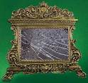
Then, Dorian….
Poor, poor Dorian…

Slide 9
Essays
College essay
Hamlet versus Macbeth
Author Project
Dorian Gray personal essay
And a few minor ones here and there!

Slide 10
College?
Whether you are going to college or not, this is a college prep class
When you are done here, you will be ready!
Also, keep close attention to your grades!
You have to pass to Graduate!
Contact me by phone or email for any problems or concerns!

Slide 11
The End

